Slide 1

Crowd Monitoring Robot using YOLO and Deep SORT
Team Number: A6
Team Members:
K B Mani Rohith - CB.AI.U4AID23016
Ram Lasya - CB.AI.U4AID23030
Sai Venkata Ganesh - CB.AI.U4AID23049
M Abhishiktha - CB.AI.U4AID23063
19/01/2026.
Page no. 1

Slide 2
Contents
Introduction
Problem Statement
Objective of the Project
System Overview
Methodology
Crowd Counting and Behavior Analysis
Heatmap Analysis
Results and Conclusion
Model Training Performance and Loss Analysis
Crowd Density and Alert Analysis
Heatmap
References
19/01/2026
Page no. 2

Slide 3
Introduction
This project focuses on using computer vision and artificial intelligence to monitor crowd density in video surveillance systems.
A head detection model is trained using annotated images to accurately identify people in video frames.
The system analyses each frame of the video, detects heads, and counts the number of people in a defined alert area.
If the crowd exceeds a specified threshold, the system triggers an alert.
This helps improve public safety by automatically detecting overcrowding and analysing crowd behaviour in real time.
19/01/2026
Page no. 3

Slide 4
Problem Statement
Manually monitoring crowd density in public places using CCTV cameras is difficult and inefficient.
There is a need for an automated system that can detect people in videos and identify overcrowding in specific areas in real time.
19/01/2026
Page no. 3

Slide 5
Objective of the Project
The objective of this project is to design a vision-based crowd monitoring system that:
To develop an AI-based system that detects human heads in images and video frames using object detection.
To monitor crowd density in a defined alert area and identify overcrowding situations.
To analyse crowd behavior by recording detection data and generating visual graphs.
To improve public safety by automatically detecting and alerting when crowd limits are exceeded.
19/01/2026.
Page no. 4

Slide 6
Literature Review
S.No | Paper Name | Year | Key Idea | Method Used | Research Gap
1. | Human Detection and Crowd Counting using YOLO | 2023 | Detect and count people in crowded scenes for surveillance applications. | YOLO object detection with deep learning models. | Accuracy decreases in highly dense crowds and complex environments.
2. | A YOLO-Based Method for Real-Time Crowd Detection from Video | 2023 | Detect people in a predefined area and monitor crowd size in real time. | YOLO models trained on COCO dataset with region-based counting. | Limited ability to analyze crowd behavior or movement patterns
3. | Crowd Density Prediction using Deep Learning | 2024 | Estimate crowd density from images using deep learning models. | CNN-based crowd density estimation techniques. | Does not focus on real-time video surveillance applications.
4. | Smart Crowd Monitoring System using IoT and YOLO | 2024 | Real-time crowd monitoring system integrated with IoT-based surveillance. | YOLO detection combined with IoT devices and video analytics. | Requires additional hardware and complex deployment infrastructure.
5. | Human Detection and Counting using YOLOv4 | 2024 | Detect and count humans using YOLOv4 with high real-time performance. | CNN-based YOLOv4 detection and Flask-based deployment. | Limited crowd density analysis and visualization techniques.
6. | Estimating Crowd Density with Edge Intelligence | 2022 | Improve real-time crowd density estimation using lightweight models for edge devices. | MobileNetV2 based CNN with dilated convolution. | Accuracy trade-off due to lightweight model design.
7. | Crowd Density Estimation for Video Surveillance | 2022 | Review of deep learning methods for analyzing crowd density in surveillance videos. | Transfer learning and deep CNN-based crowd analysis. | Most methods focus only on density estimation and not detection-based counting.
8. | Density Estimation and Crowd Counting | 2025 | Improve crowd counting accuracy using density map generation techniques. | Diffusion-based probabilistic models for density map estimation. | High computational complexity and limited real-time deployment
19/01/2026.
Page no. 5

Slide 7
System Overview
Dataset Preparation: Images containing human heads are collected and annotated in Roboflow to create a dataset for training the detection model.
Model Training: A YOLOv11 object detection model is trained on the dataset to accurately detect human heads in images and video frames.
Video Processing: The trained model is integrated with a Python program that processes the input video frame by frame using OpenCV.
Crowd Detection and Monitoring: The system detects heads in each frame, counts the number of people, and checks how many are inside a predefined alert zone.
Alert and Data Analysis: If the number of people in the alert area exceeds a set threshold, the system triggers an alert and stores the data for further analysis and visualization.
19/01/2026
Page no. 6

Slide 8
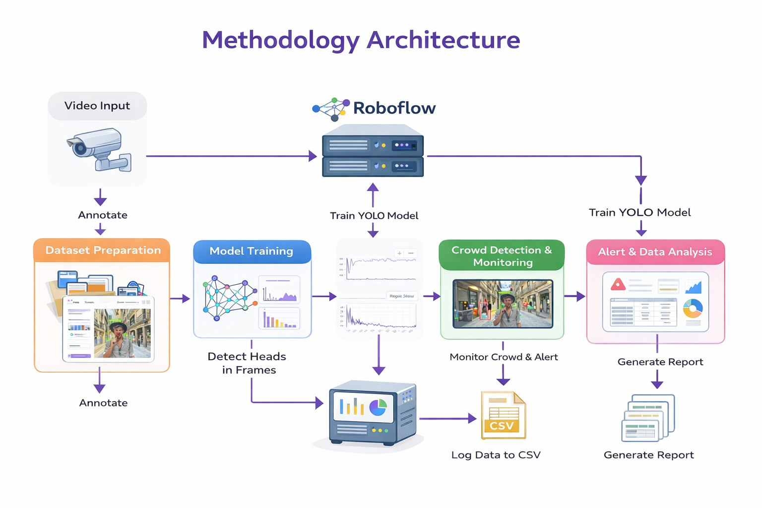
Methodology
19/01/2026
Page no. 7

Slide 9
Crowd Counting and Behavior Analysis
Head Detection and Counting: The system detects human heads in each video frame using the trained model and counts the total number of people present.
Zone Monitoring: A predefined alert area is created in the video, and the system checks how many detected people fall inside this zone.
Crowd Density Analysis: The system continuously monitors the number of people in the alert area to understand the crowd density.
Overcrowding Detection: If the number of people in the zone exceeds the predefined threshold, the system identifies it as overcrowding and triggers an alert.
19/01/2026
Page no. 8

Slide 10
Results and Conclusion
The trained YOLO model successfully detected human heads in video frames with high accuracy (around 96.4% mAP).
The system was able to count people and monitor crowd density in the defined alert zone in real time.
Overcrowding situations were detected when the number of people exceeded the predefined threshold.
The system generated useful outputs such as processed detection videos, crowd statistics, and analysis graphs.
Overall, the project demonstrates that AI-based computer vision can effectively support automated crowd monitoring and improve public safety.
19/01/2026
Page no. 9

Slide 11
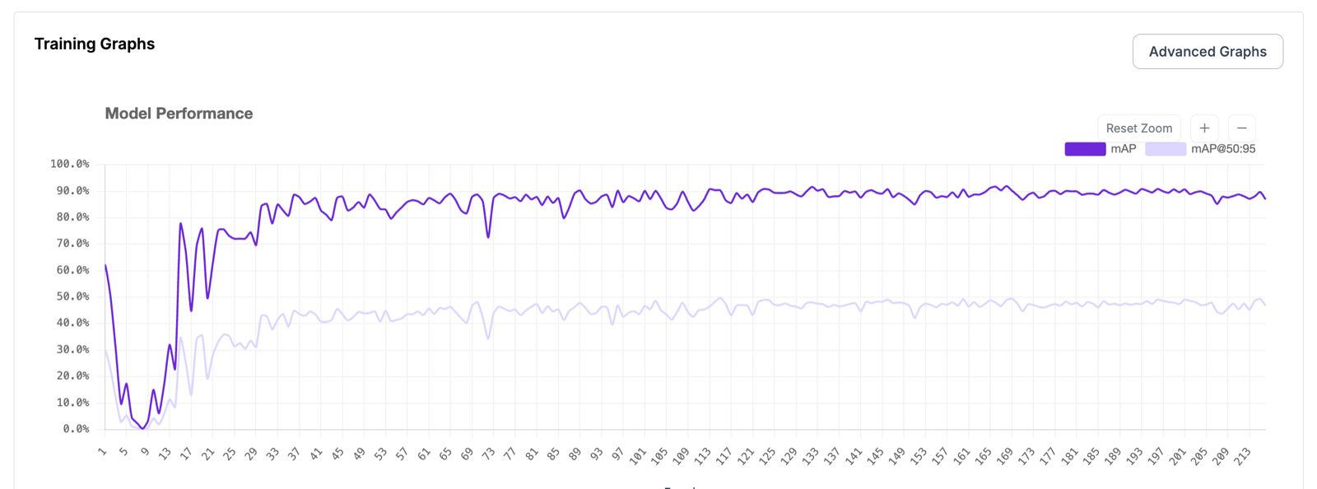
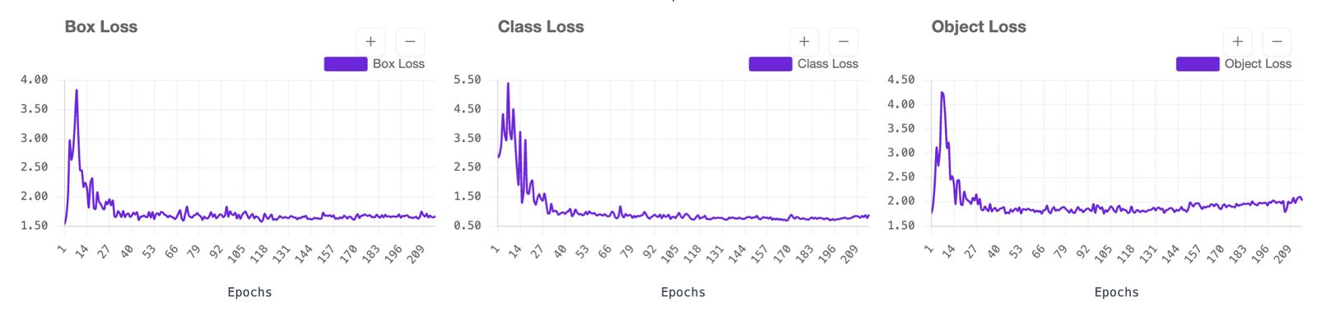
Model Training Performance and Loss Analysis
19/01/2026
Page no. 10

Slide 12
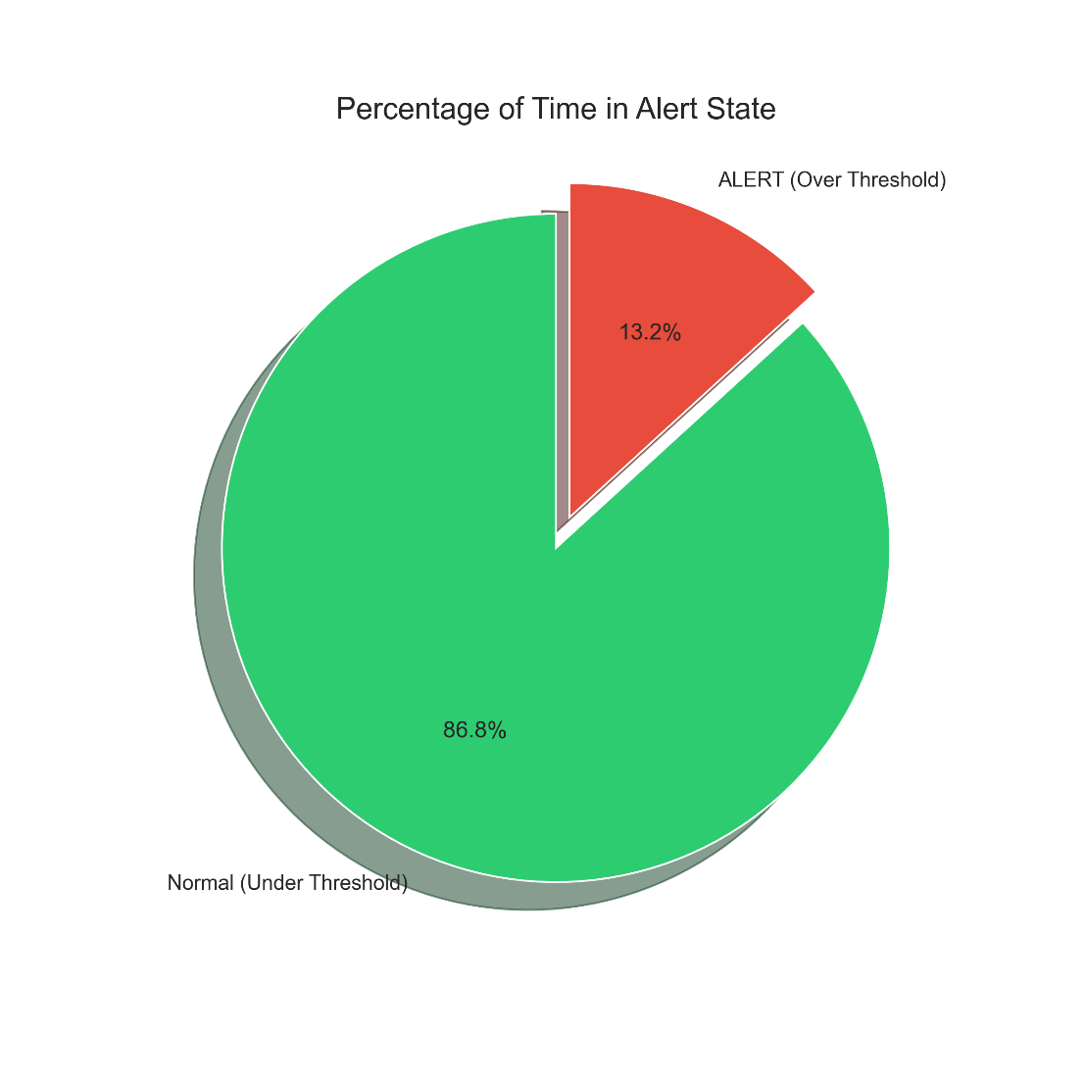
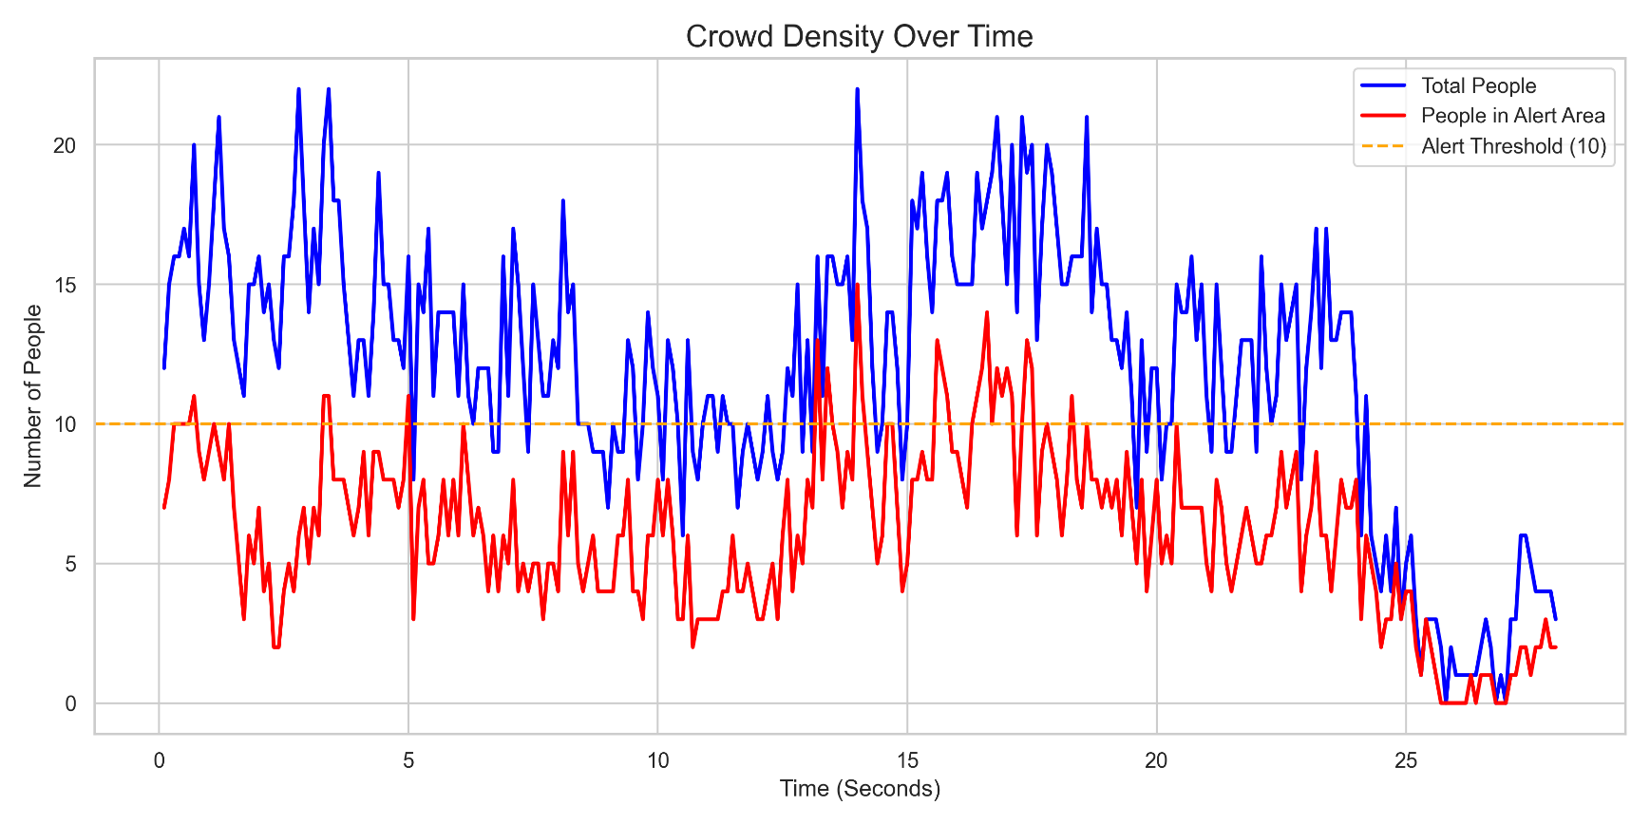
Crowd Density and Alert Analysis
19/01/2026
Page no. 11

Slide 13
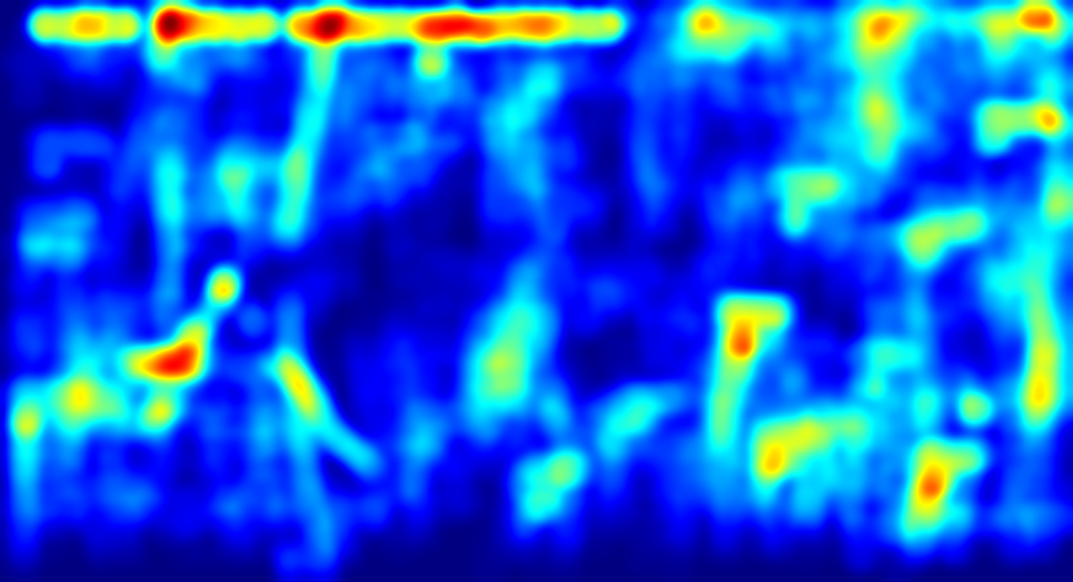
Heatmap
The heatmap shows how frequently people appear in different areas of the video over time.
Red and yellow areas indicate locations with high crowd concentration, while blue areas represent low or no crowd activity.
The bright regions highlight crowd hotspots, showing where people tend to gather the most.
This visualization helps understand crowd movement patterns and crowded zones, which is useful for monitoring and safety planning.
19/01/2026
Page no. 12

Slide 14
Future Scope
Improved Detection Accuracy: Future work can include training the model with larger and more diverse datasets to improve detection accuracy in complex or highly crowded environments.
Integration with Smart Alert Systems: The system can be connected with automated alert systems or mobile notifications to instantly inform security personnel when overcrowding is detected.
19/01/2026
Page no. 13

Slide 15
References
[1] X. Xiao and X. Feng, “Multi-Object Pedestrian Tracking Using Improved YOLOv8 and OC-SORT,” Sensors, vol. 23, no. 20, 2023.
[2] M. Badauraudine, M. N. M. Noor, M. S. Othman, and H. B. M. Nasir, “Detection and Tracking of People in a Dense Crowd through Deep Learning Approach – A Systematic Literature Review,” Information Research Communications, vol. 1, no. 2, pp. 65–73, 2024.
[3] S. Padmalal et al., “A real-time design for dense crowd enumeration via tracking using AI system,” AIP Conference Proceedings, 2025.
[4] R. Chavan et al., “CrowdDCNN: Deep convolution neural network for real- time crowd counting on IoT edge,” Eng. Appl. AI, 2023.
[5] A. A. Lubis, A. Prasasta, and D. A. Sari, “Towards Efficient Crowd Counting and Behavior Analysis Using YOLOv11,” Int. J. Tech. Model., vol. 4, no. 1, pp. 35–47, 2025.
19/01/2026
Page no. 14

Slide 16
Thank you
19/01/2026
Page no. 15

